Slide 1
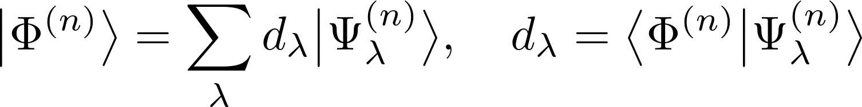
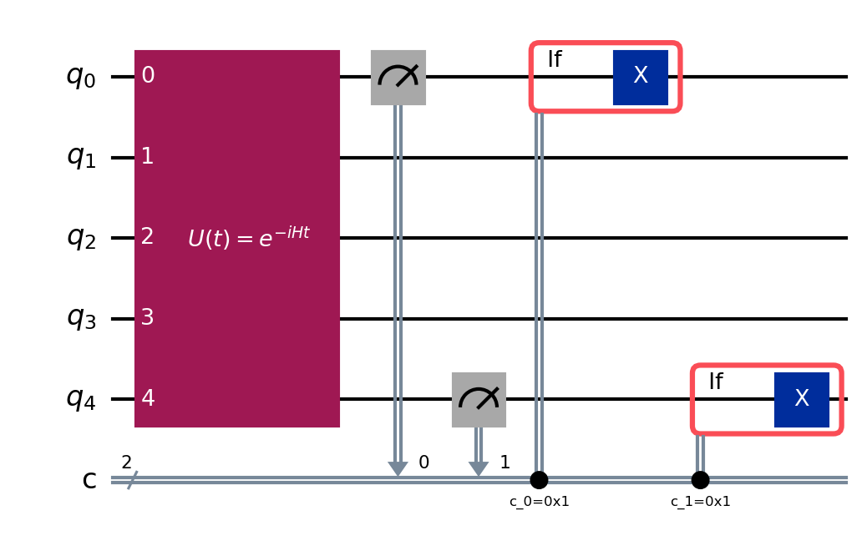
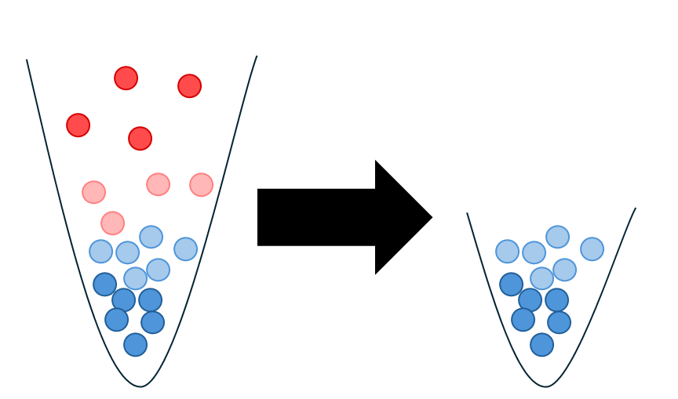
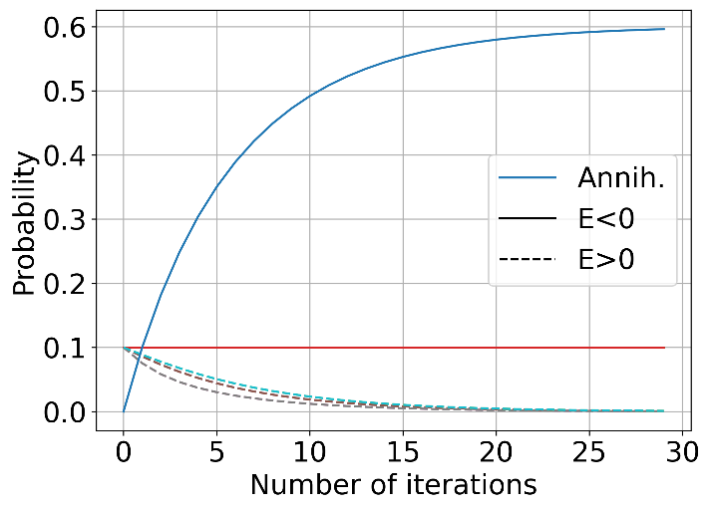
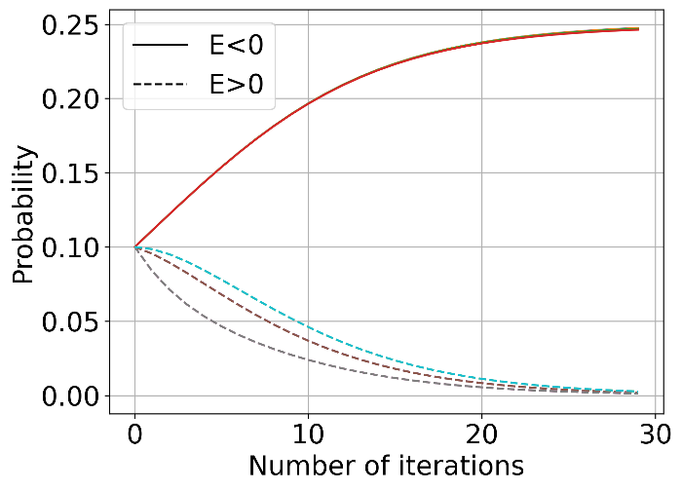
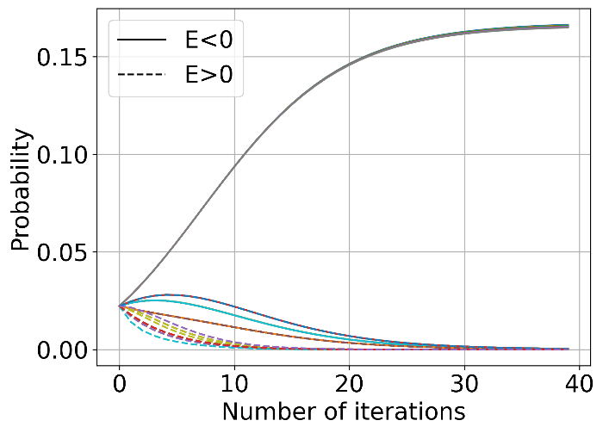
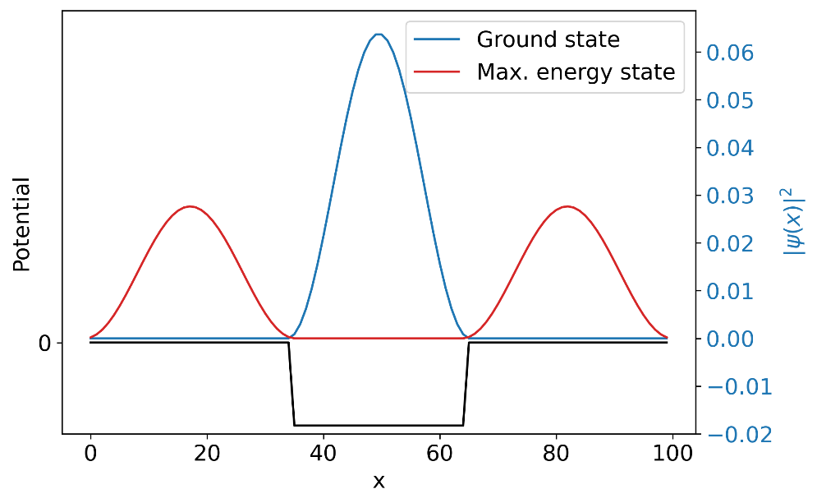
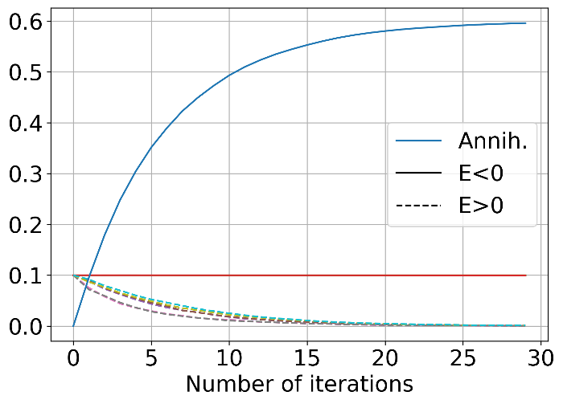
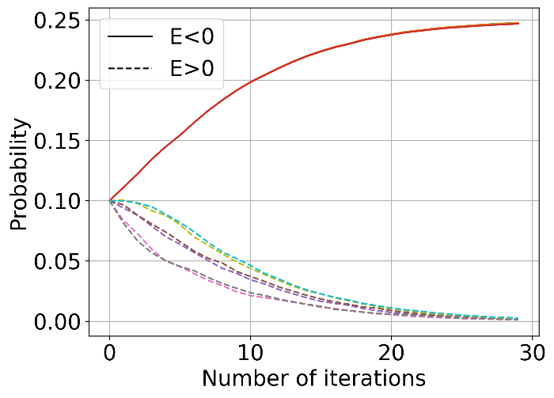
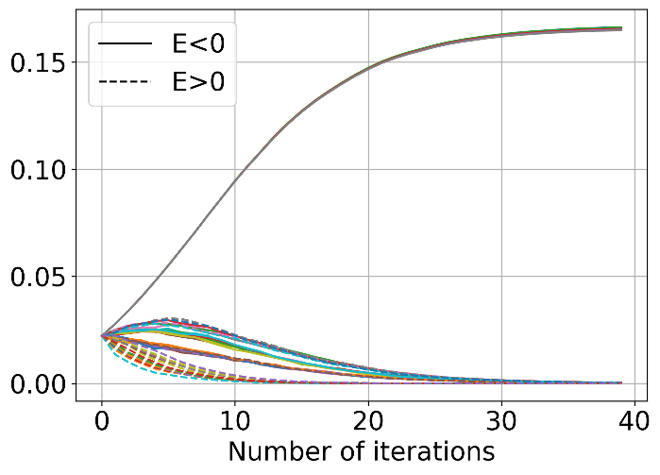
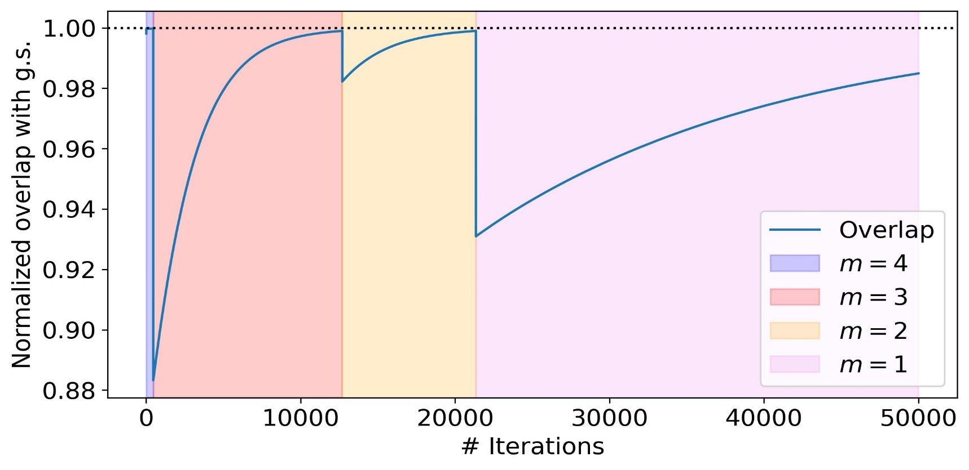
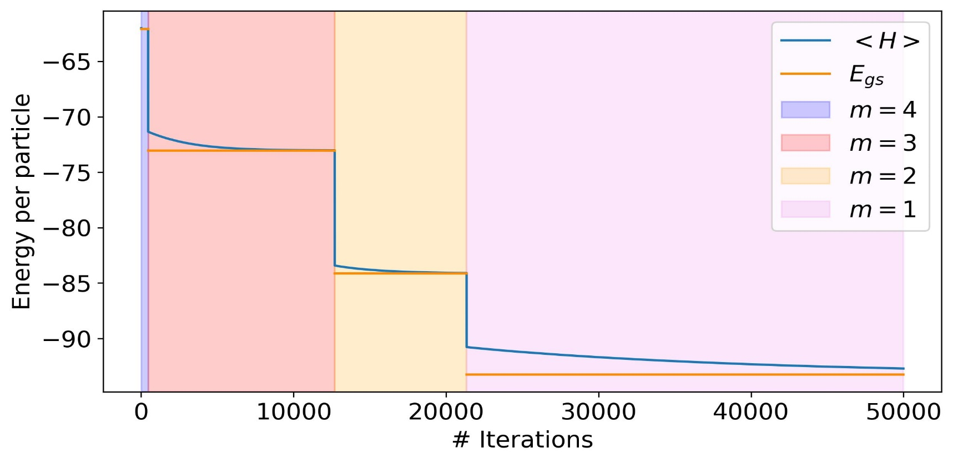
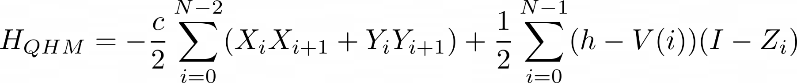




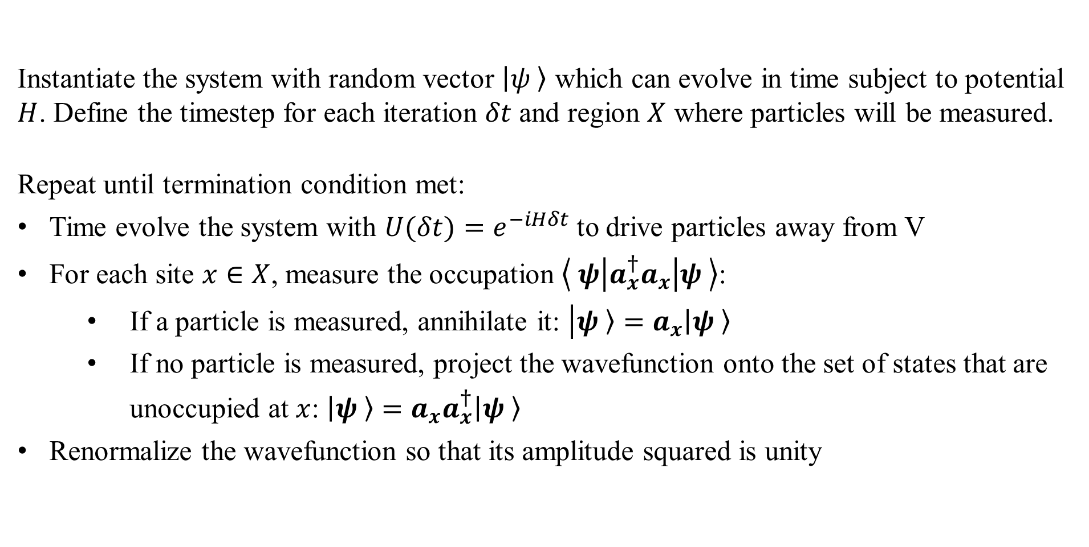
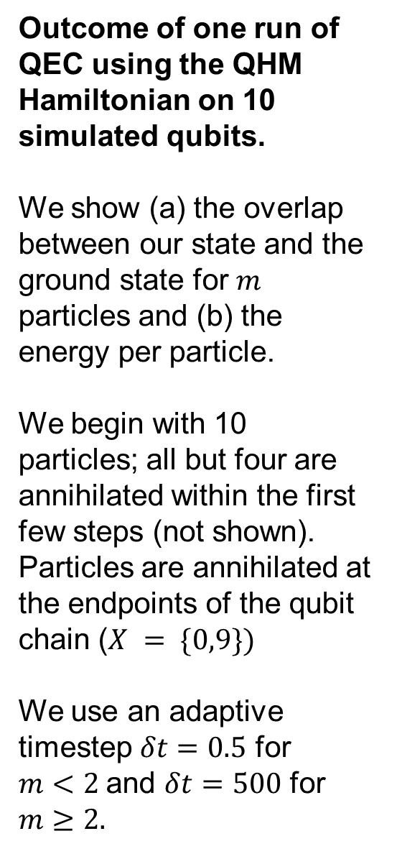
Quantum Evaporative Cooling: Algorithm for Low-Energy State Preparation of Many-Body Systems
Paul-Aymeric McRae, Dean Lee, Morten Hjorth-Jensen
Abstract
Description of the Algorithm
Theory
The problem of finding eigenstates of a Hamiltonian is well-studied in the field of quantum computing. However, the convergence of many state-of-the-art eigensolver methods depends on the overlap between the ansatz state and the target eigenvector. In view of this, we introduce Quantum Evaporative Cooling, an iterative and stochastic quantum computing algorithm which constructs the ground state (or a mixture of low-energy eigenstates) of a Hamiltonian with a localized potential well within some larger volume. The outcome of this algorithm can then be kept as a desired result or used as an ansatz for a second quantum process. In an analogue to classical evaporative cooling, we drive particles far away from our local potential towards the boundaries of our volume. We then eliminate "hot" particles near the boundary and, if no such particles are measured, suppress contributions to the wavefunction located in this boundary region. This method allows us to treat a variety of many-body Hamiltonians and sweep through multiple fixed-particle-number subspaces of such Hamiltonians.
Instantiate the system with random vector $\left|ψ\left. \right\rangle \right.$ which can evolve in time subject to potential $H$. Define the timestep for each iteration $δt$ and region $X$ where particles will be measured.
Repeat until termination condition met:
Time evolve the system with $U(δt)=e^{−iHδt}$ to drive particles away from V
For each site $x∈X$, measure the occupation $\left\langle ψ | a_{x}^{†}a_{x} | ψ \right\rangle$:
If a particle is measured, annihilate it: $\left|ψ\left. \right\rangle =a_{x}\left|ψ\left. \right\rangle \right.\right.$
If no particle is measured, project the wavefunction onto the set of states that are unoccupied at $x$: $\left|ψ\left. \right\rangle \right.=a_{x}a_{x}^{†}\left|ψ\left. \right\rangle \right.$
Renormalize the wavefunction so that its amplitude squared is unity
Since QEC is a stochastic algorithm, the final state will be different after each experiment. Consequently, the theory underlying QEC is best analyzed using an ensemble of runs of the algorithm.
Any $n$-particle state $\left|Φ^{(n)}\left. \right\rangle \right.$ can be decomposed into a weighted sum of the $n$-particle eigenstates of the Hamiltonian.
Evolving the system in time will change the relative phases between states but not the magnitude of the weights. When dealing with ensembles of runs it is convenient to deal with the square of the weights ${\left|d_{λ}\right|}^{2}$ as this will ignore information about phases. The term ${\left|d_{λ}\right|}^{2}$ is the probability to measure the system in the $λ$^{th} eigenstate.
We can calculate the effect of one iteration of the algorithm on $\left|\left.Ψ_{λ}^{(n)}\right\rangle \right.$and determine the probability to remain in that state, to transition to a different state, or to annihilate a particle. These probabilities allow us to use a discrete-time Markov chain to simulate the algorithm. We find that the low-energy states which are highly localized within our trap form nearly stationary distributions of the Markov stochastic matrix. This means that low-energy states survive after numerous iterations of QEC while high-energy states are suppressed.
If we run QEC numerous times with long, random times between iterations, we should find the average probability to measure each eigenstate will reproduce the outcome of the Markov chain analysis.
(Quantum) Evaporative Cooling
$$c_{0}=1$$
The Quantum Evaporative Cooling (QEC) Algorithm takes inspiration from the evaporative cooling process for trapped atoms. In this process, a mixture of hot and cold atoms are trapped in a finite-depth potential. The atoms all have some kinetic energy, but only the hottest ones can escape the trap, and are removed from the system, leaving the colder atoms behind.
QEC combines the concept of eliminating hot particles with the projected cooling technique. In a quantum system, the position of a particle is not known until it is measured. To perform quantum evaporative cooling, we must measure whether any particles are found outside the well. The outcome of this measurement (which acts as a projection operator) is stochastic and will collapse the wavefunction. If no particle is measured, the collapsed wavefunction will be completely localized within the trap. If a particle is measured, it is annihilated.
$$c_{1}=1$$
Evaporative Cooling. By lowering the potential depth, the hot particles are allowed to escape.
Schematic circuit diagram of QEC using 5 qubits with $X = \{0,4\}$. Newer QPUs allow mid-circuit measurement of qubits and classical feed-forward control flow.
Quantum Evaporative Cooling in Action
(a)
(b)
(c)
One-particle eigenstates of QHM. Low energy-states are localized within the trap. Measuring particles outside the trap will suppress higher-energy excited states.
Outcome of one run of QEC using the QHM Hamiltonian on 10 simulated qubits.
We show (a) the overlap between our state and the ground state for $m$ particles and (b) the energy per particle.
We begin with 10 particles; all but four are annihilated within the first few steps (not shown). Particles are annihilated at the endpoints of the qubit chain ($X = \{0,9\})$
We use an adaptive timestep $δt=0.5$ for
$m<2$and $δt=500$ for $m≥2.$
Probability to measure each eigenstate using Markov chain analysis (top) vs average of 500 runs (bottom). (a) probability of all outcomes for 1 particle (b) probabilities of (a) renormalized to remove annihilations (c) 2-particle renormalized probabilities
Qubit Representation of Many-Body System
We can use bitstrings to represent the Hilbert space of N qubits with the basis:
$\left|b_{1},\left.…, b_{N}\right\rangle \right.$, $b_{i}∈\{0,1\}$.
These bitstrings can also be used describe the occupation representation of the Fock space of a system of up to $N$ particles. Thus $N$-body systems can be represented using $N$ qubits.
We let each $b_{i}$ correspond to a single-particle state which can be occupied or unoccupied. Using a 1-D lattice to discretize space, we take the single-particle states to represent position, e.g. $b_{x}=1$ would mean a particle is located at position $x$.
Second-quantized problems, written in terms of creation/annihilation operators $a_{x}^{†}$ and $a_{x}$ can be rewritten in terms of qubit gates. This encoding allows us to represent hard-core bosonic systems and fermionic systems with non-periodic boundary conditions. In our experiments we use the Quantum Heisenberg Model, with an attractive potential $V(x)$:
References and Acknowledgements
(a)
Lee, D., et al. "Projected cooling algorithm for quantum computation," in Physics Letters B, vol. 807, pp. 135536, 2020.
M. Girardeau. "Relationship between Systems of Impenetrable Bosons and Fermions in One Dimension," in Journal of Math. Phys., vol. 1, no. 6, pp. 516-523, 1960.
W. Ketterle, N. Druten. "Evaporative Cooling of Trapped Atoms," in Advances in Atomic Molecular and Optical Physics, vol. 37, pp. 181-236, 1996.
The authors of this work would like to acknowledge support from Department of Energy grant DE-SC0023658 and National Science Foundation grant PHY-2310620.
(b)

